Slide 1
Narrator contrast magnifier keyboard

Slide 2
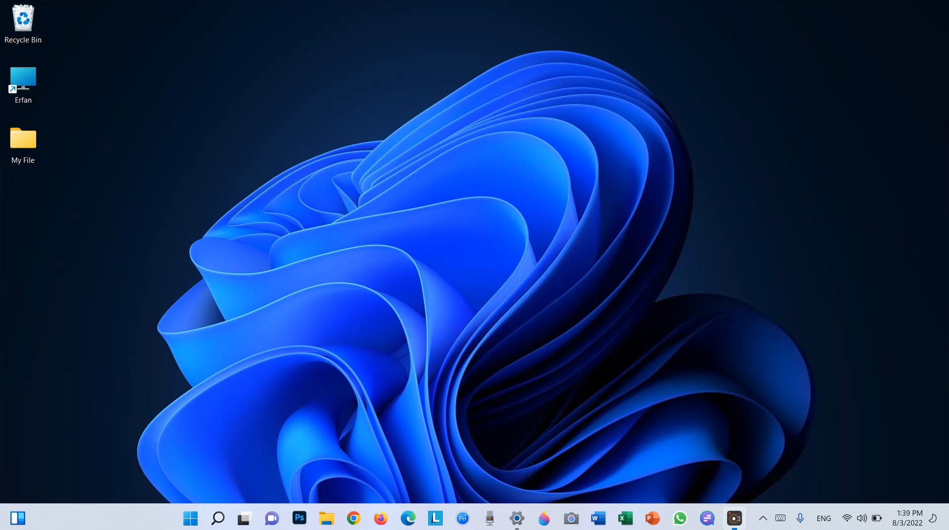
narrator

Slide 3


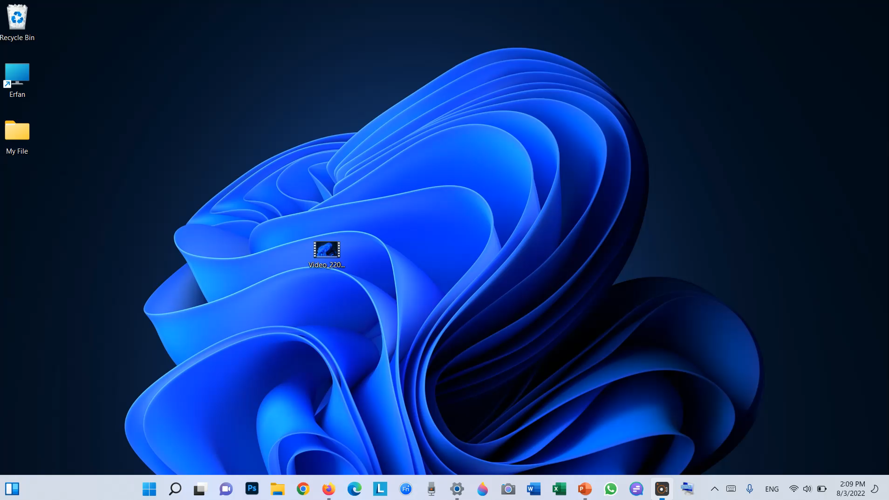

contrast

Slide 4

magnifier

Slide 5


keyboard

Slide 6
The end

