Slide 1

Grammar
Passive Voice
وجه مجهول

Slide 2


میلاد غذا را خورد.
Active voice
مفعول
فاعل
جمله معلوم: جملاتی که در آن فاعل یا انجام دهنده مشخص است.
غذا خورده شد.
Passive voice
مفعول(نائب فاعل)
جمله مجهول: جملاتی که در آن فاعل یا انجام دهنده مشخص نیست یامهم نیست بلکه خود عمل مهم است، در این جملات مفعول جایگزین فاعل می شود.
جملاتی را میتوان مجهول کرد که فعل آنها متعدی (transitive) باشد، لذا افعال لازم (intransitive) را نمی توان مجهول کرد
متعدی:بردن، نگاه کردن، آوردن لازم: افتادن، رفتن ، آمدن
نکته
مهمترین افعال لازم ( intransitive ) در زبان انگلیسی:
agree / appear / arrive / die / get up / go/ happen / inquire / laugh / live / look /occur remain / rise / seem / sit / sleep / wait / work
نکته
دلیل استفاده از ساختار مجهول در جملات این است که: عمل انجام شده بیشتر از فاعل برای ما مهم است و اینکه قصد نداریم فاعل در جمله وجود داشته باشد.
نکته

Slide 3

ساختار جمله مجهول
بقیه جمله + ( فاعل by / with +) + قسمت سوم فعل ( p.p ) + مشتقات فعل to be + مفعول جمله معلوم
مشتقات فعل to be
am / is / are
was / were
been / be / being / to be
نحوه تبدیل جملات
معلوم به مجهول
Leo saw the pigeon on the window
ابتدا فاعل را حذف می کنیم.
saw the pigeon on the window
سپس مفعول جمله معلوم را ابتدای جمله قرار می دهیم.
the pigeon saw on the window
با توجه به زمان جمله و همچنین مفرد یا جمع بودن مفعول ، فعل to be مناسب را قرار می دهیم.
the pigeon was saw on the window
پس از قرار دادن فعل to be شکل سوم فعل یعنی past participle را می نویسیم.
the pigeon was seen on the window ( by Leo )

Slide 4
My mother cleans the room everyday.
The room is cleaned by my mother everyday.
فاعل
فعل اصلی
مفعول
زمان
مفعول
be
قسمت سوم فعل
by + فاعل
زمان

Slide 5
The mechanic fixed my car yesterday.
My car was fixed by the mechanic yesterday.
فاعل
فعل اصلی
مفعول
زمان
مفعول
be
قسمت سوم فعل
by + فاعل
زمان

Slide 6
The man can/should/may/must clean his car.
His car can/should/may/must be cleaned.
فاعل
فعل کمکی
فعل اصلی
مفعول
مفعول
فعل کمکی
be
قسمت سوم فعل

Slide 7
Passive Voice in English
زمان | نحوه ساخت جمله مجهول | جمله معلوم | جمله مجهول
حال ساده | am / is / are + p.p | He drives his car | His car is driven
حال استمراری | am / is / are + being + p.p | They are playing tennis | Tennis is being played
حال کامل | has / have + been + p.p | John has washed his hands | His hands have been washed
گذشته ساده | was / were + p.p | We drank two bottles of water | Two bottles of water were drunk
گذشته استمراری | was / were + being + p.p | I was watching TV | TV was being watched
آینده ساده | will / be going to + be+ p.p | You’re going to erase mistakes She will answer all questions | Mistakes are going to be erased All questions will be answered

Slide 8
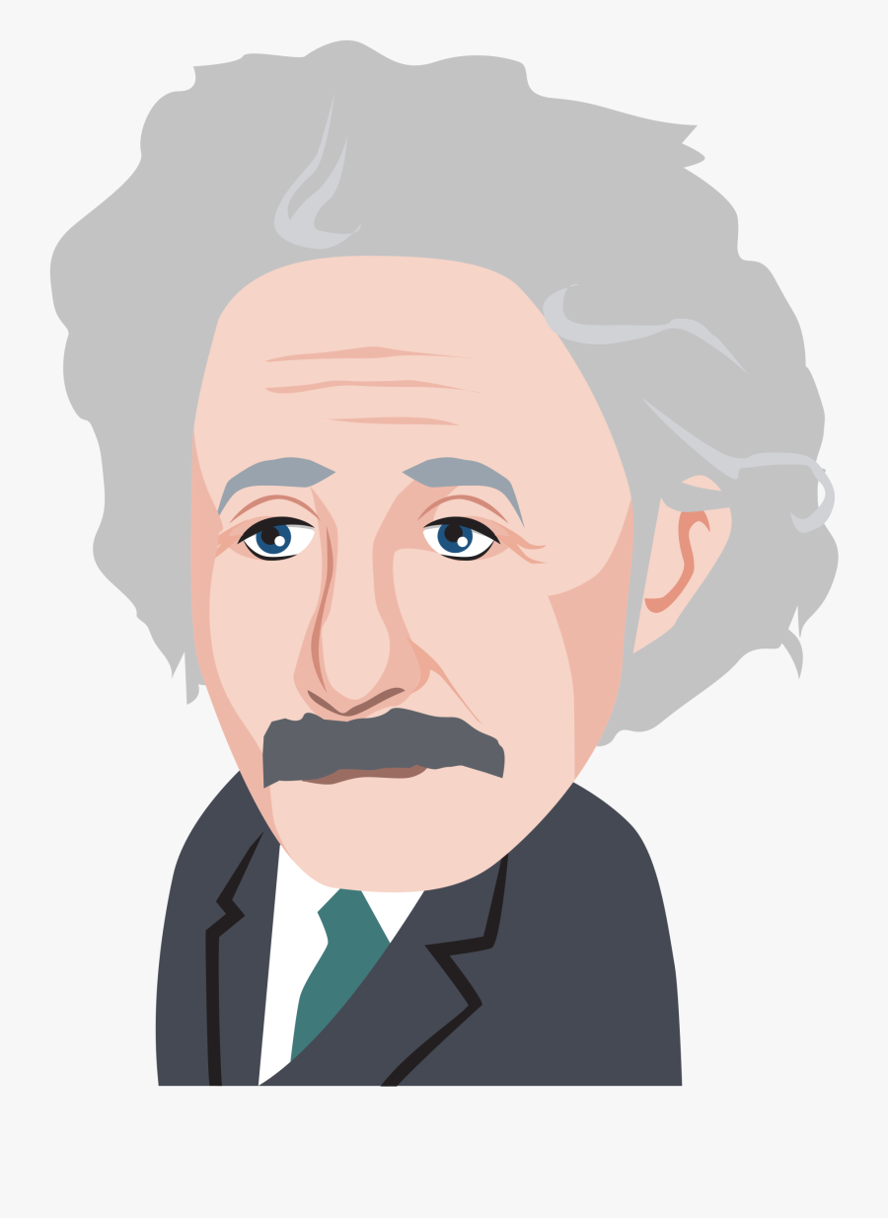
جمله مجهول در زمان حال ساده
Active: Subject + Verb + Object + …… .
Passive: Object + am / is / are + Past Participle
She opens the window
The window is opened by her
They write the letters
The letters are written by them
I brush my teeth
My teeth are brushed by me
Junior sends the presents
The presents are sent by Junior
Government devotes a lot of money to the poor people
A lot of money is devoted to the poor people by government
We do our homework at home every day
Our homework is done by us at home every day

Slide 9
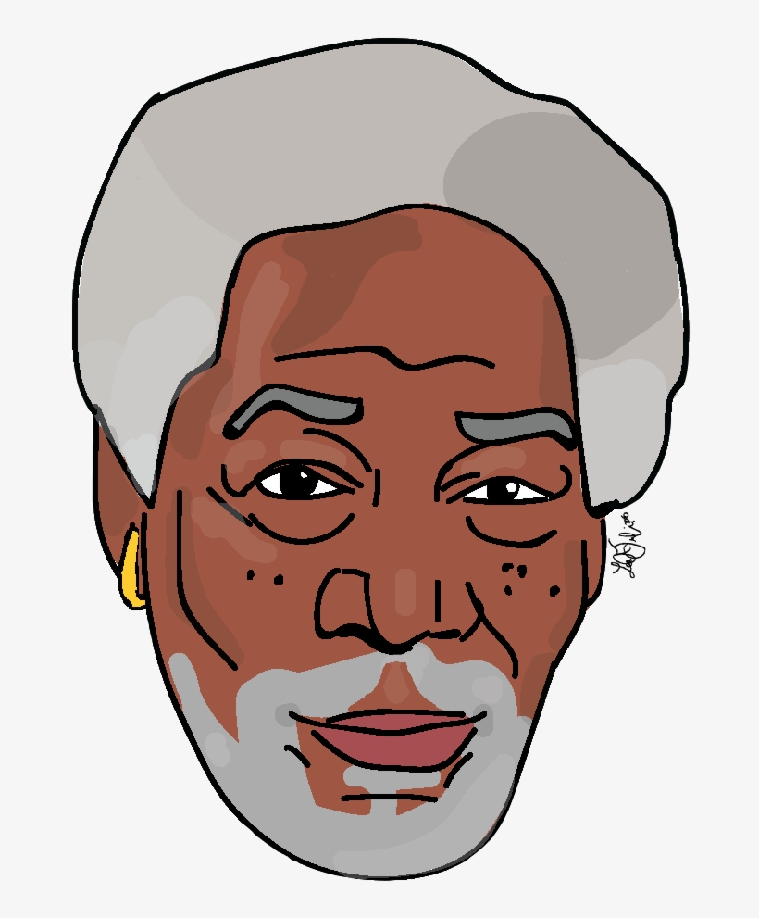
جمله مجهول در زمان حال استمراری
Active: Subject + am / is / are + Verb + ing + Object + …… .
Passive: Object + am / is / are + being + Past Participle
He is closing the door
The door is being closed by him
Kim is painting the walls
The walls are being painted by Kim
I am throwing the ball
The ball is being thrown by me
My father is calling me
I am being called by my father
They are kissing their old mom right now
Their old mom is being kissed by them right now
You are playing soccer in the yard
The soccer is being played by you in the yard

Slide 10

جمله مجهول در زمان حال کامل
Active: Subject + have / has + Past Participle + Object + …
Passive: Object + have / has + been + Past Participle
She has washed the dishes
The dishes have been washed by her
John has watered the flowers
The flowers have been watered
I have written the letter
The letter has been written by me
We have invited Lora
Lora has been invited by us
You have booked a nice room in this modern hotel
A nice room in this modern hotel has been booked by you
Our community has solved the problems
The problems have been solved by our community

Slide 11
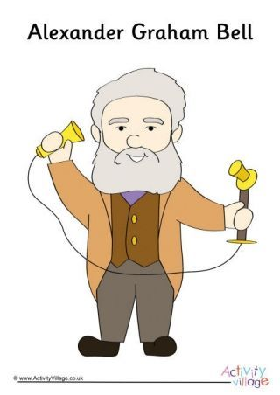
جمله مجهول در زمان گذشته ساده
Active: Subject + Verb + Object + ……
Passive: Object + was / were + past participle
I cleaned my room
My room was cleaned by me
He bought a few books
A few books were bought by him
We watched two movies
Two movies were watched by us
Susan read a novel yesterday
A novel was read by Susan yesterday
Our teacher explained the passive voice greatly
The passive voice was greatly explained by our teacher
You washed your hands for thirty seconds
Your hands were washed for thirty seconds

Slide 12

جمله مجهول در زمان گذشته استمراری
Active: Subject + was / were + Verb+ ing + Object + ……
Passive: Object + was / were + being + Past Participle
Paul was watching cartoon
Cartoon was being watched by Paul
They were studying English
English was being studied by them
I was putting on my shoes
My shoes were being put on by me
We were teaching math
Math was being taught by us
He was feeding a nice parrot in the cage
A nice parrot in the cage was being fed by him
Mike and I were eating a sandwich
A sandwich was being eaten by us

Slide 13
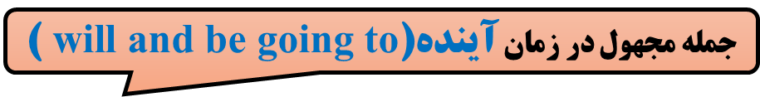
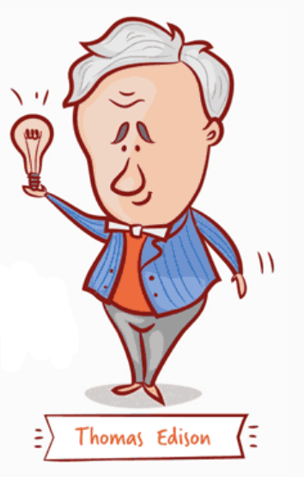
Active: Subject + will / be going to + Verb + Object + ……
Passive: Object + will / be going to + be + Past Participle
Brad will carry the bag
The bag will be carried by Brad
They will drink water
Water will be drunk by them
I am going to speak French
French is going to be spoken by me
Sue will deliver the document
The document will be delivered by Sue
My brother will show a good performance
A good performance will be shown by my brother
Justin and you are going to find an answer
An answer is going to be found by you

Slide 14
VERY IMPORTANT POINTS

Slide 15
1. سوالی یا منفی کردن جمله مجهول
برای سوالی یا منفی کردن جملات مجهول از اولین فعل کمکی استفاده می کنیم
The piano is not being played
He is playing the piano
Is the piano being played?
2. فعل های دارای دو مفعول
give / send / show / promise / lend / offer / ask / tell
teach / pay / buy / sell / make / borrow / bring / teach
A question was asked of me by him
He asked me a question
I was asked a question by him
Two options are offered to him
They offer him two options
He is offered two options

Slide 16
3. نحوه آوردن فاعل در جمله مجهول
در صورتیکه فاعل جمله معلوم انسان باشد در انتهای جمله فاعلby + را می آوریم
اما در صورتیکه فاعل ابزار، وسایل یا ماده باشد از with استفاده می کنیم
John killed Marvel
Marvel was killed by John
A stone killed Marvel
Marvel was killed with a stone
Harsh clouds darkened the sky
The sky was darkened with harsh clouds
10. قید تکرار و یا حالت در جملات مجهول کجا می آید؟
در صورت وجود قید حالت یا تکرار در جمله معلوم، در جمله مجهول باید این قید را بین to be و p.p بیاوریم.
My brother drives a car slowly
A car is slowly driven by my brother

